Slide 2

Welcome

Slide 3
Intro to Calculations: Estimating the Airspeed Velocity of an Unladen Swallow
#IntroCalcs
Alex Cortez
Product Consultant
Kate Tinsley
Product Consultant

Slide 4
Alex Cortez acortez@tableau.com Kate Tinsley ktinsley@tableau.com
#IntroCalcs

Slide 5
Aggregation & Disaggregation If – Then Analysis String Calculations Booleans (True/False) Date Calculations Advanced Calculations
Agenda

Slide 6
SESSION REPEATS
Day of Week, Month Day Session Title
Time – Time | Location
Day of Week, Month Day Session Title
Time – Time | Location
Day of Week, Month Day Session Title
Time – Time | Location

Slide 7
RELATED SESSIONS
Friday, October 23 Beginning Your Geographic Analysis Journey
11:30am – 12:30pm | Location
Friday, October 23 Beginning Your Geographic Analysis Journey
11:30am – 12:30pm | Location
Friday, October 23 Beginning Your Geographic Analysis Journey
11:30am – 12:30pm | Location

Slide 8
Aggregation & Disaggregation

Slide 9
If-Then Analysis

Slide 10
String Calculations

Slide 11
Boolean Calculations

Slide 12
Date Calculations

Slide 13
Advanced Calculations

Slide 14
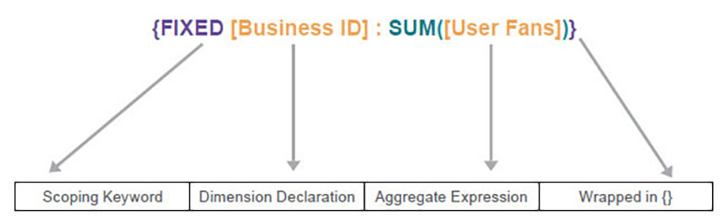

Slide 15
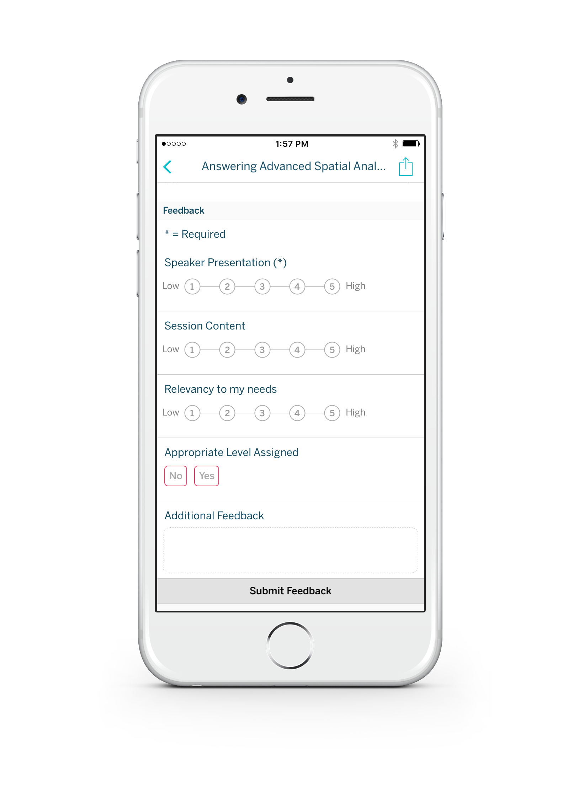
Please complete the session survey from the Session Details screen in your TC17 app

Slide 16
Please complete the session survey from the Session Details screen in your TC17 app

